Slide 1
Splash Screen

Slide 2
Lesson Menu
Five-Minute Check (over Lesson 6–5)
Then/Now
New Vocabulary
Example 1: Real-World Example: Determine the Scale
Example 2: Real-World Example: Find Actual Measurements
Example 3: Real-World Example: Construct a Scale Drawing

Slide 3
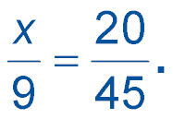
5-Minute Check 1
Solve the proportion
A. 3
B. 4
C. 5
D. 6

Slide 4
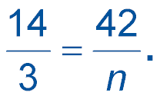
5-Minute Check 2
Solve the proportion
A. 7
B. 8
C. 9
D. 10

Slide 5
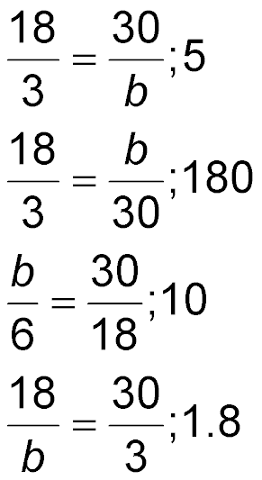
5-Minute Check 3
Write a proportion. Then solve. 18 donuts in 3 boxes, 30 donuts in b boxes
A.
B.
C.
D.

Slide 6
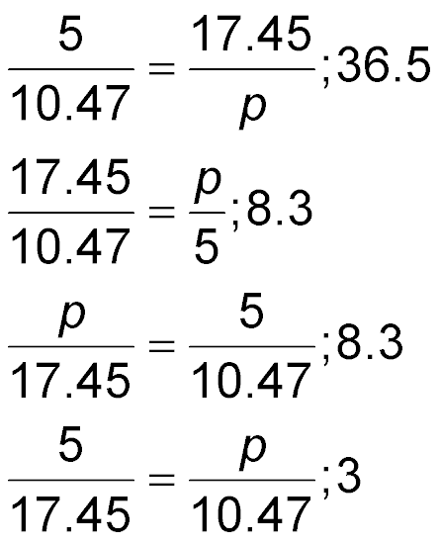
5-Minute Check 4
Write a proportion. Then solve. 5 pounds of meat for $17.45, p pounds of meat for $10.47
A.
B.
C.
D.

Slide 7
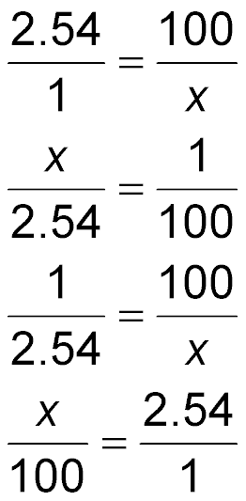
5-Minute Check 5
There are approximately 2.54 centimeters in 1 inch. Write a proportion to find the length, in inches, of a meter stick (100 centimeters).
A.
B.
C.
D.

Slide 8
5-Minute Check 6
Angie notices that for every 32 eggs her hen lays, one will be brown while the rest are white. If Angie’s hen produces 416 eggs, how many could Angie predict would be brown?
A. 8
B. 11
C. 13
D. 16

Slide 9
Then/Now
You have already written and solved proportions. (Lesson 6–5)
Use scale drawings.
Construct scale drawings.

Slide 10
Vocabulary
scale drawing
scale model
scale
scale factor

Slide 11
Example 1
Determine the Scale
MODEL CAR A model car is 4 inches long. The actual car is 12 feet long. What is the scale of the model?
Write the ratio of the length of the model to the actual length of the car. Then solve a proportion in which the length of the model is 1 inch and the actual length is x feet.
model length →
← model length
actual length →
← actual length
Find the cross products.
Simplify.

Slide 12
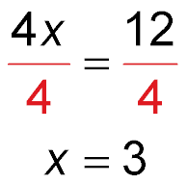
Example 1
Determine the Scale
Divide each side by 4.
Simplify.
Answer: The scale is 1 inch = 3 feet.

Slide 13
Example 1
LOG CABIN A model log cabin is 12 inches high. The actual log cabin is 42 feet high. What is the scale of the model?
A. 1 inch = 3.5 feet
B. 1 inch = 42 feet
C. 2 inches = 7 feet
D. 1 inch = 3.5 inches

Slide 14
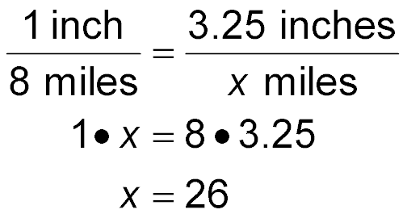
Example 2
Find Actual Measurements
MAP A map has a scale of 1 inch = 8 miles. Two towns are 3.25 inches apart on the map. What is the actual distance between the two towns?
Method 1 Use a proportion.
Let x represent the actual distance between the two towns. Write and solve a proportion.
map distance →
← map distance
actual distance →
← actual distance
Find the cross products.
Simplify.
Answer: The actual distance between the two towns is 26 miles.

Slide 15
Example 2
Find Actual Measurements
Method 2 Use the scale factor.
Find the scale factor.
Convert 8 miles to inches.

Slide 16
Example 2
Find Actual Measurements
So, the actual distance a is 506,880 times the map distance m.
a = 506,880m Write the equation.
= 506,880(3.25) Replace m with 3.25.
= 1,647,360 Simplify.
Answer: The actual distance is 1,647,360 inches or
26 miles.

Slide 17
Example 2
SCALE DRAWING A scale drawing of a new house has a scale of 1 inch = 4 feet. The height of the living room ceiling is 2.75 inches on the scale drawing. What is the actual height of the ceiling?
A. 1.45 feet
B. 48 feet
C. 11 feet
D. 6.88 feet

Slide 18
Example 3
Construct a Scale Drawing
PATIO DESIGN Sheila is designing a patio that is 16 feet long and 14 feet wide. Make a scale drawing of the patio. Use a scale of 0.5 inch = 4 feet.
Step 1 Find the measure of the patio’s length on the drawing. Let represent the length.
drawing length →
← drawing length
actual length →
← actual length
Find the cross products.
Simplify.
Divide each side by 4.

Slide 19
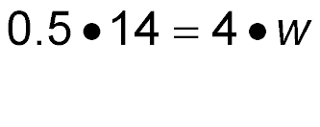
Example 3
Construct a Scale Drawing
On the drawing, the length is 2 inches.
Step 2 Find the measure of the patio’s width on the drawing. Let w represent the width.
drawing length →
← drawing length
actual length →
← actual length
Find the cross products.
Simplify.

Slide 20
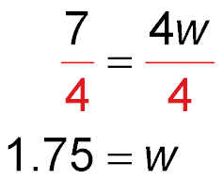
Example 3
Construct a Scale Drawing
Divide each side by 4.
Simplify.

Slide 21
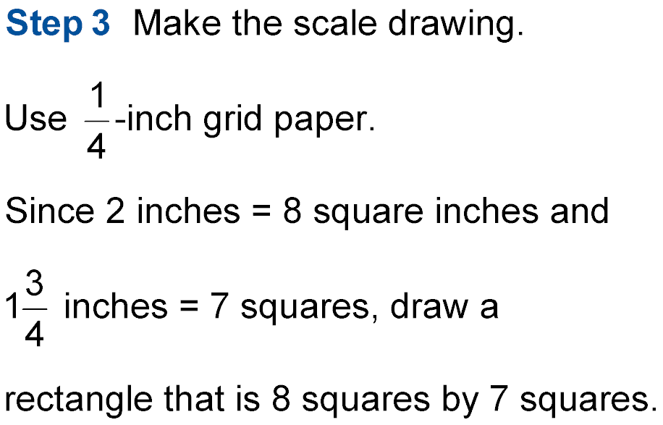
Example 3
Construct a Scale Drawing

Slide 22
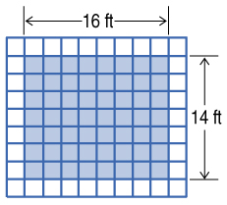
Example 3
Construct a Scale Drawing
Answer:

Slide 23
Example 3
A. length = 6 squares width = 5 squares
B. length = 9 squares width = 7 squares
C. length = 4.5 squares width = 3.5 squares
D. length = 5 squares width = 6 squares

Slide 24
End of the Lesson

